Slide 1
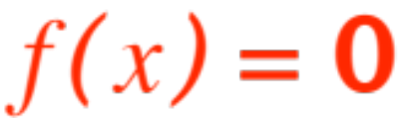
NEWTON’S METHOD
(OR: FINDING YOUR ROOTS)
(NOT a genealogy concept)
They say a picture is worth a thousand words.
Here is a picture (observed by Sir Isaac Newton,
I guess) which gave him the germ of an idea
for devising a method that iteratively finds
solutions of equations of the form
(remember those bottoms of which we had to find roots?) Naturally the method carries his name.
Here is the figure:

Slide 2
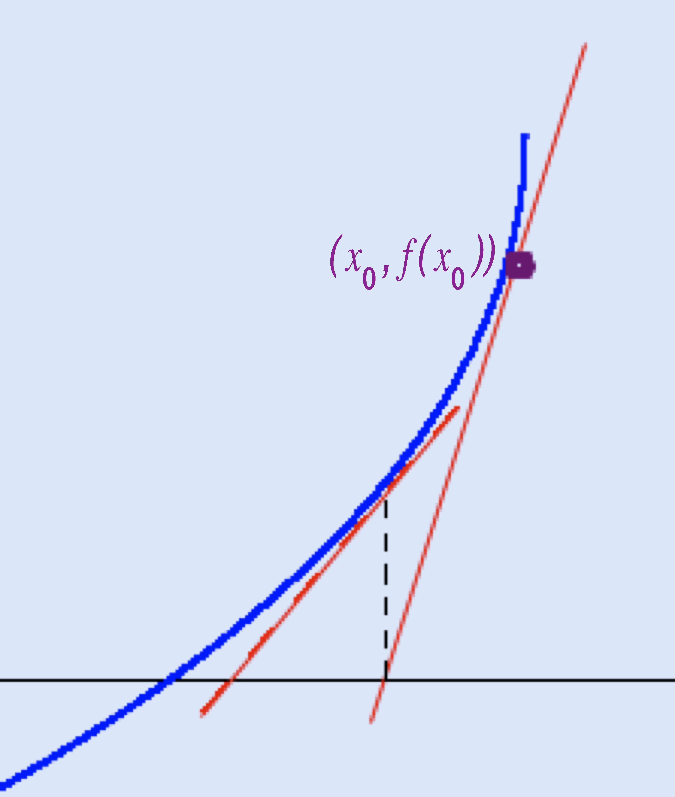
Are you as clever as Sir Isaac?
What do you see?

Slide 3
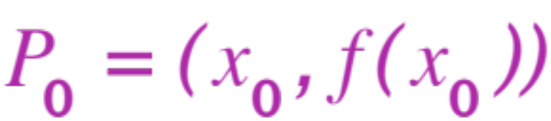
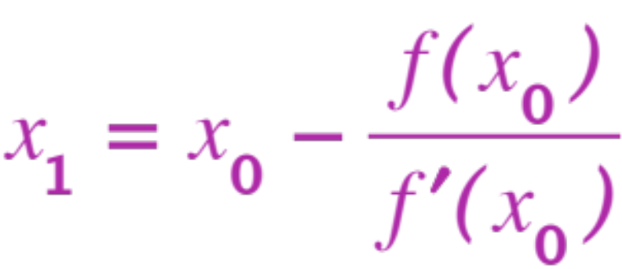
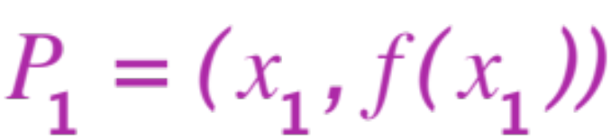
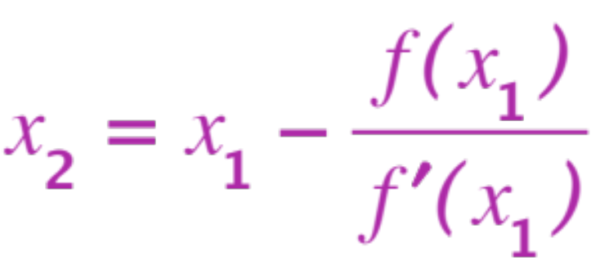
Right !, successive x-intercepts of tangent lines get closer and closer to roots.
More precisely:
Take a point .
The x-intercept of the tangent at
Is (check it out !)
The x-intercept of the tangent at
Is (check it out !)

Slide 4
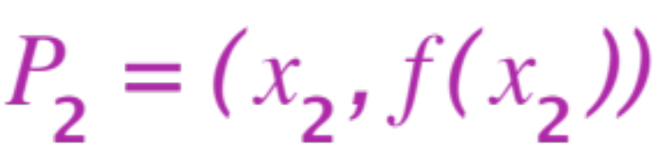

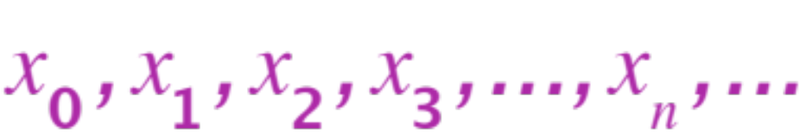
Keep on going,
The x-intercept of the tangent at
Is (check it out !)
The sequence of numbers
has two lovely properties:

Slide 5
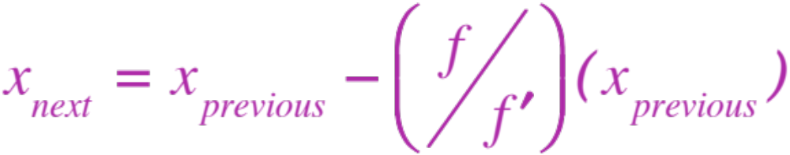



After you have guessed (or have dreamt, have asked grandma, have been given) the first one, the rest are computed by the same formula
When things are kosher ( does not hit ,
is not too wild), the sequence
gets closer and
closer to a root of !
A few comments:

Slide 6
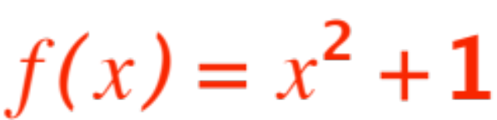
The method is not foolproof. It depends a lot on the initial guess.
The method can be extremely efficient, if the first guess is a good one.
The method is ideal for an Excel spreadsheet (i’ll show you.)
The function may have no roots, the method will fail, try

Slide 7
A final story: Very many years ago the manufac-turer of a “financial” pocket calculator had a program that, given the amount of a loan, the time it took to pay it and the monthly payment, would display the interest rate charged.
Trouble was, it took a rather long time to do it.
A friend interested in finances asked me for help and I discovered that the program (using Newton’s method) ALWAYS made the initial guess 0.5 ! It often needed ~ 50 iterations !
I rewrote the program taking 0.15 (a more realis-tic interest rate) as initial guess and would get the answer in no more than 3 ~ 4 iterations.

Slide 8
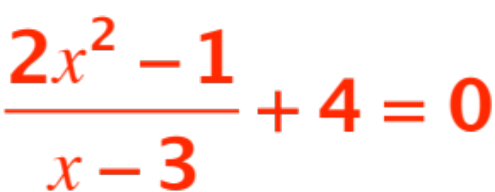
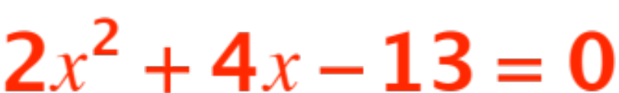
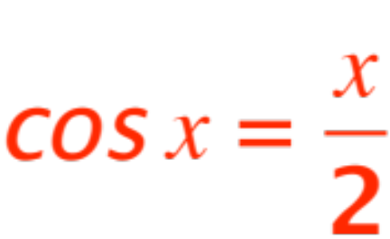
Now we are going to have fun using an Excel spreadsheet I have prepared.
You be prepared to suggest equations we might want to solve. I will do:
and .
Note that your pocket calculator
is of no help here!

